Slide 1




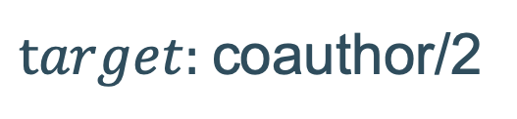

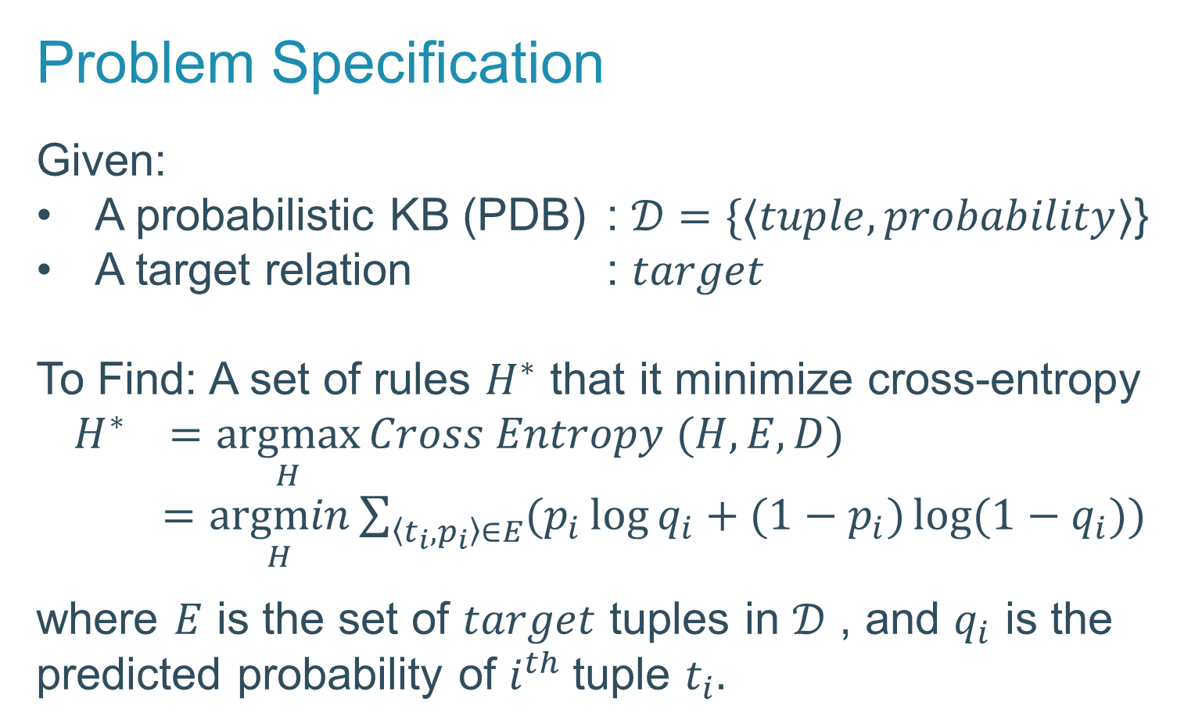
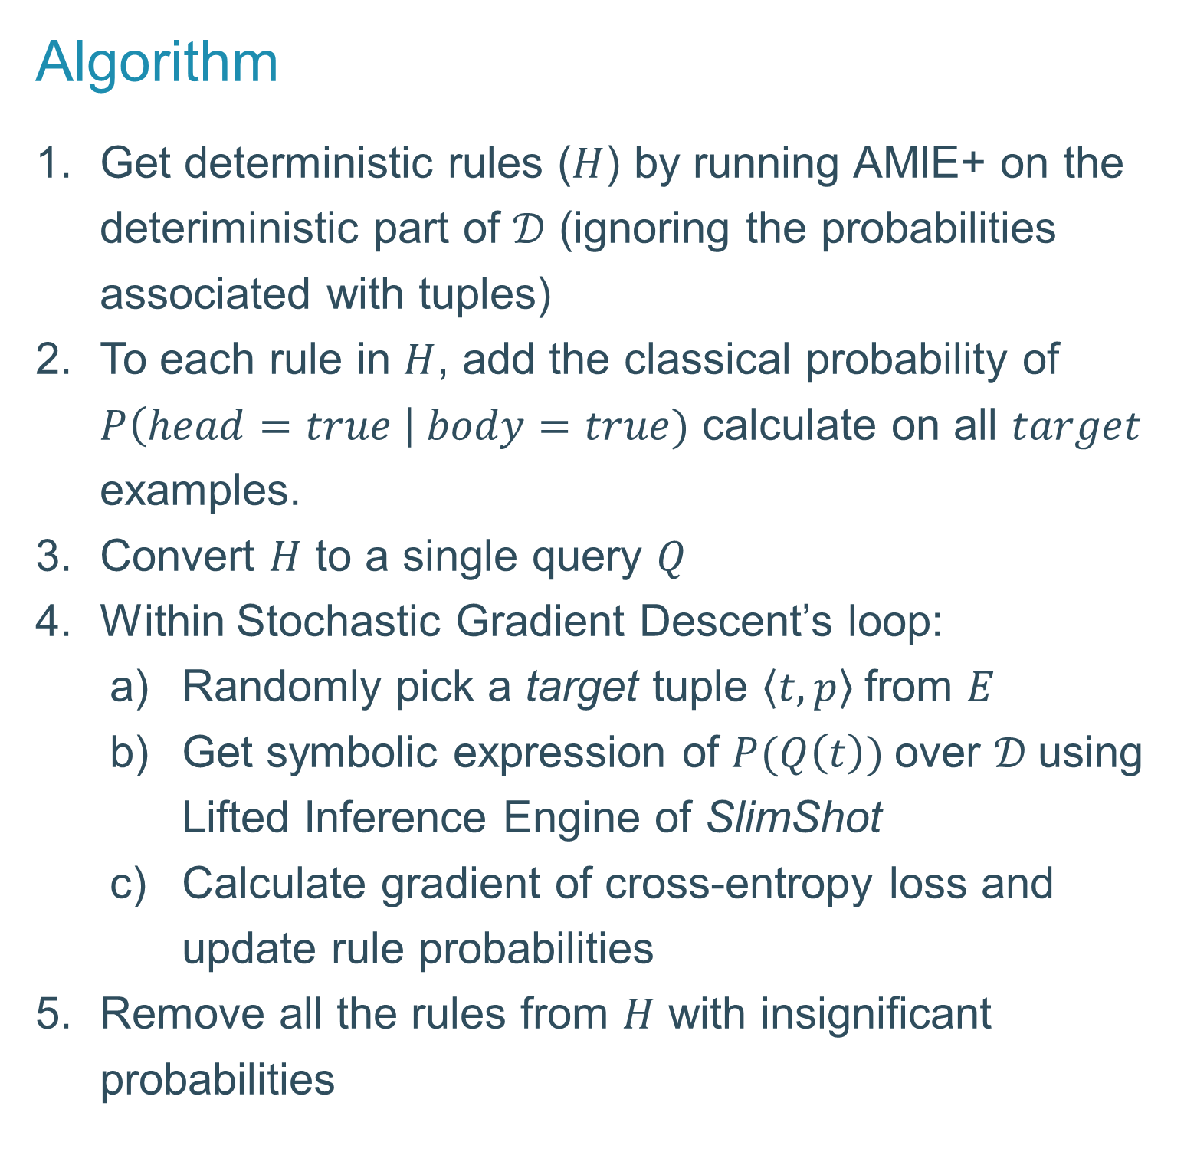
Scalable Rule Learning in Probabilistic Knowledge Bases
Arcchit Jain | Tal Friedman | Ondřej Kuželka | Guy Van den Broeck | Luc De Raedt
KU Leuven | UCLA | KU Leuven | UCLA | KU Leuven
SafeLearner
Knowledge Bases (KBs) are becoming increasingly:
What is new?
We use Lifted Inference to learn probabilistic rules for completion of such large and probabilistic KBs
Why Rule Learning?
Handles probabilistic KBs (PDBs)
Completes KBs in an explainable way
Why SafeLearner?
Significantly faster than ProbFOIL⁺ and scales as good as AMIE+ (Runtime under 2.5 hours on KB with 14k+ tuples)
Problem Specification
Given:
A probabilistic KB (PDB) : $𝒟=\{⟨tuple, probability⟩$}
A target relation : $target$
To Find: A set of rules $H^{∗}$ that it minimize cross-entropy $H^{∗} =\underset{H}{argmax}{Cross Entropy (H, E, D)}$
$=\underset{H}{argmin}\sum_{\left\langle t_{i}, p_{i}\right\rangle ∈E}{(p_{i}\log{q_{i}}+(1−p_{i})\log{(1−q_{i})})}$
where $E$ is the set of $target$ tuples in $𝒟$ , and $q_{i}$ is the predicted probability of $i^{th}$tuple $t_{i}.$
Larger | Probabilistic | Incomplete
Algorithm
Get deterministic rules ($H$) by running AMIE+ on the deteriministic part of $𝒟$ (ignoring the probabilities associated with tuples)
To each rule in $H$, add the classical probability of $P\left(head=true \right| body=true)$ calculate on all $target$ examples.
Convert $H$ to a single query $Q$
Within Stochastic Gradient Descent’s loop:
Randomly pick a target tuple $\left\langle t, p\right\rangle$from $E$
Get symbolic expression of $P(Q\left(t\right))$over $𝒟$using Lifted Inference Engine of SlimShot
Calculate gradient of cross-entropy loss and update rule probabilities
Remove all the rules from $H$ with insignificant probabilities
Example
AMIE+ Rules($H$):
$\text{coauthor}\text{(}\text{A}\text{, }\text{B}\text{) :− }\text{author}\text{(}\text{A}\text{, }\text{C}\text{), }\text{author}\text{(}\text{B}\text{, }\text{C}\text{).}$
$\text{coauthor}\text{(}\text{A}\text{, }\text{B}\text{) :− }\text{location}\text{(}\text{A}\text{, }\text{C}\text{), }\text{location}\text{(}\text{B}\text{, }\text{C}\text{).}$
Query ($Q$): ${∃ a, b s.t. p}_{h_{1}}∨{( p}_{h_{2}} ∧location\left(a,c\right)∧location(b, c))∨(p_{h_{3}}∧author\left(a, d\right)∧author(b,d))$
Learned Rules ($H^{∗}$):
$\text{0.}\text{105}\text{::}\text{coauthor}\text{(}\text{A}\text{, }\text{B}\text{) :− }\text{true}\text{.}$
$\text{0.}\text{687}\text{::}\text{coauthor}\text{(}\text{A}\text{, }\text{B}\text{) :− }\text{location}\text{(}\text{A}\text{, }\text{C}\text{), }\text{location}\text{(}\text{B}\text{, }\text{C}\text{).}$
$\text{0.}\text{333}\text{::}\text{coauthor}\text{(}\text{A}\text{, }\text{B}\text{) :− }\text{author}\text{(}\text{A}\text{, }\text{C}\text{), }\text{author}\text{(}\text{B}\text{, }\text{C}\text{).}$
researcher | paper | p
bob | plp | 0.9
carl | plp | 0.6
greg | plp | 0.7
ian | db | 0.9
harry | db | 0.8
researcher | researcher | p
alice | edwin | 0.2
alice | fred | 0.3
bob | carl | 0.4
bob | greg | 0.5
bob | harry | 0.6
bob | ian | 0.7
carl | greg | 0.8
carl | harry | 0.9
carl | ian | 0.8
dave | edwin | 0.7
dave | fred | 0.6
edwin | fred | 0.5
greg | harry | 0.4
greg | ian | 0.3
ian | ian | 0.2
author/2
researcher | university | p
edwin | harvard | 1.0
fred | harvard | 0.9
alice | mit | 0.6
dave | mit | 0.7
location/2
$target:$coauthor/2
Key features
Uses Lifted Inference in rule learning, thereby avoiding grounding for knowledge compilation
Uses memoization to store the canonical structures of all the queries with their probability expressions
Breaks larger queries into independent subqueries for better performance
Source code and full paper available at:
https://github.com/arcchitjain/SafeLearner/tree/AKBC19

